Slide 1
PGPDSE-FT BANGALORE APRIL21
CAPSTONE GROUP 4 INTERIM PROJECT PRESENTATION
Modeling and Predicting the Optimal First-Touch Turn Around Time
for Allocation of Tickets to Employees in an E-Commerce Company
Team MEMBERS
Anvesh Raj Chitrapu
Aquib Yasin
Kumar V
Nithin Deepak
Kavya Sreekumar
Niyantri Vishnu M
UNDER THE GUIDANCE OF:
Mrs. Vidhya K
PROJECT DOMAIN:
E-commerce

Slide 2
Objective:
Problem Statement:
The company faces the problem of prioritizing the allocation of tickets to its employees, in an attempt to resolve the ‘customer returns’ and other issues before the deadline.
As per the SOP, tickets are to be resolved within 12 days of Service Level Agreement (SLA).
To devise a model and predict the optimal day to allocate a ticket to an associate in order to meet the Service Level Agreement (SLA).

Slide 3
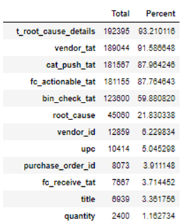
Data Understanding & Cleaning :
The dataset has 2,06,410 records and 26 attributes.
9 numerical & 17 categorical columns.
Target – ‘Rbs_tat’
Null values were present in the data.
Data type conversion – ‘Impact’ to categorical.
In ‘Assigned-to-individual’ , automated tickets were dropped.
Building Id converted to names of the warehouses.
‘Type’, ‘category’ duplicate classes were grouped into one.
One hot encoding done for categorical columns.
Missing Values
Predictor Variables
Category
Type
Item
Assigned to group
Building Location
Impact
Quantity

Slide 4
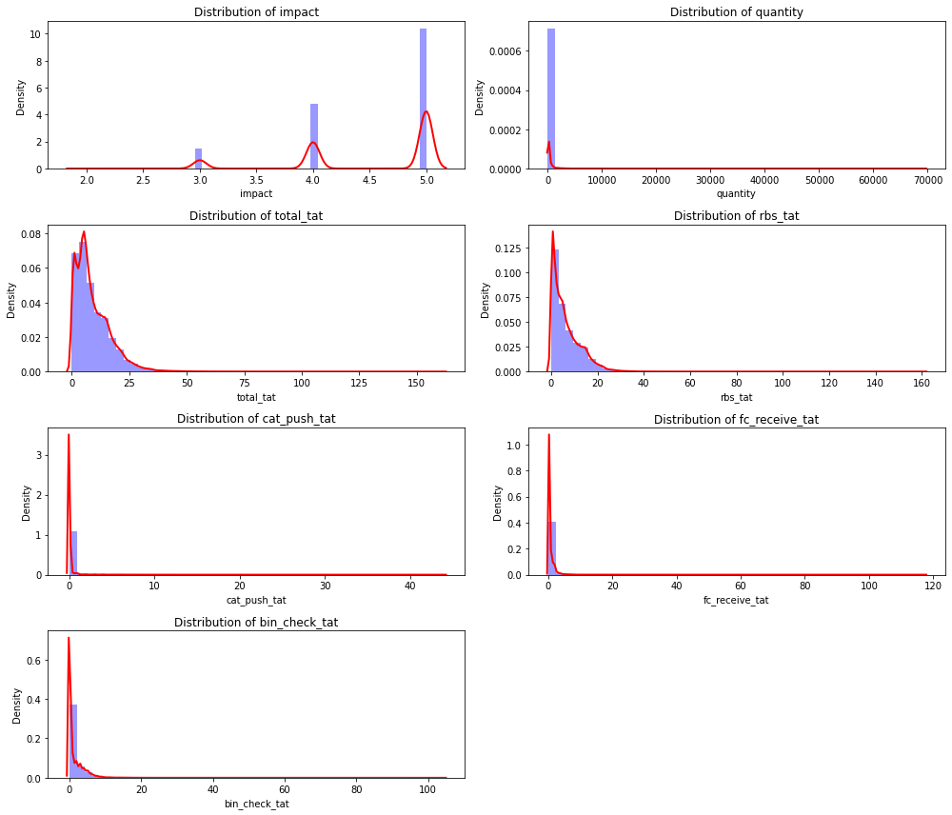
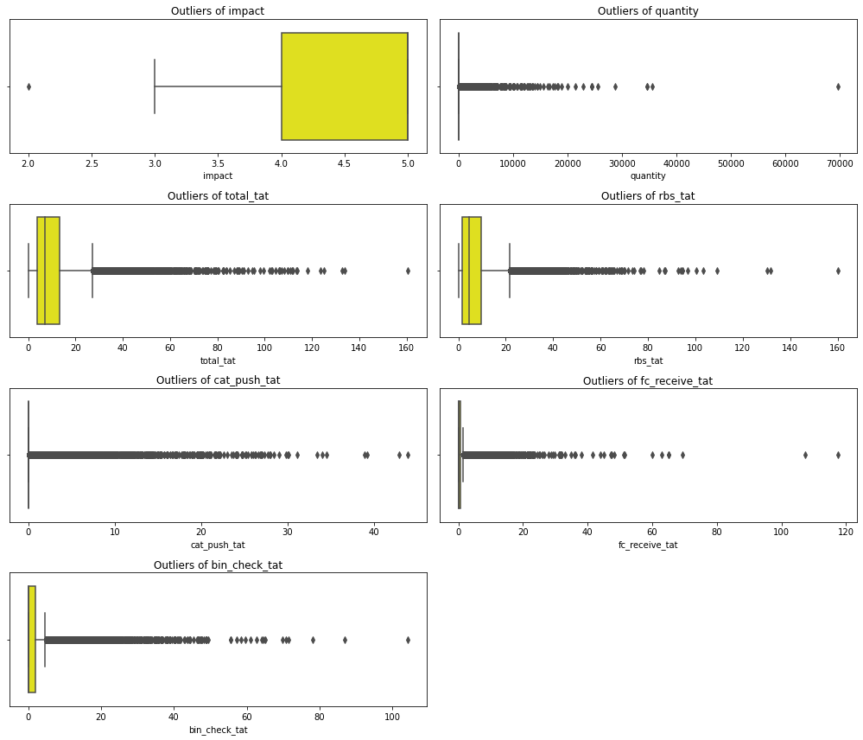
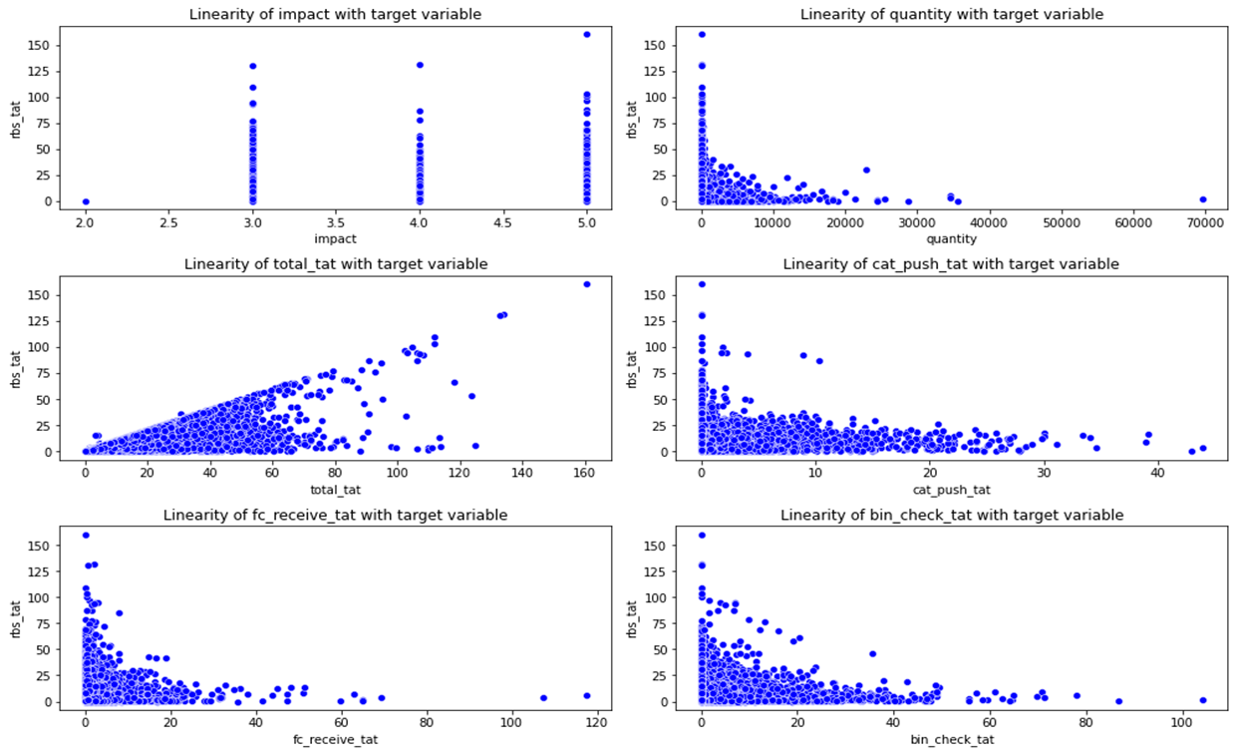
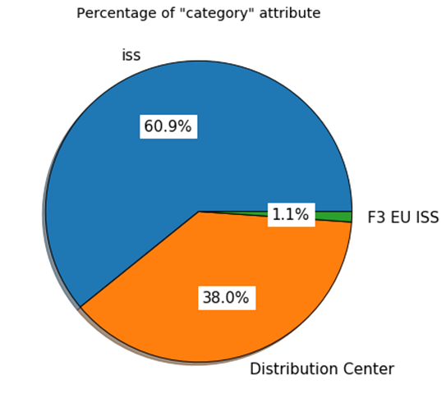
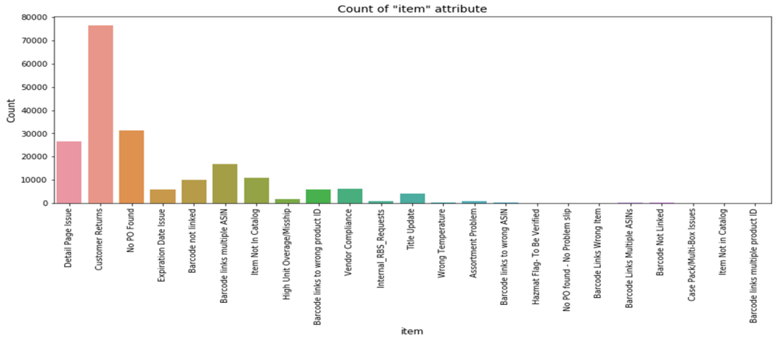
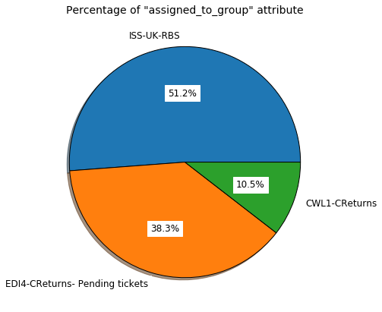
EDA :

Slide 5
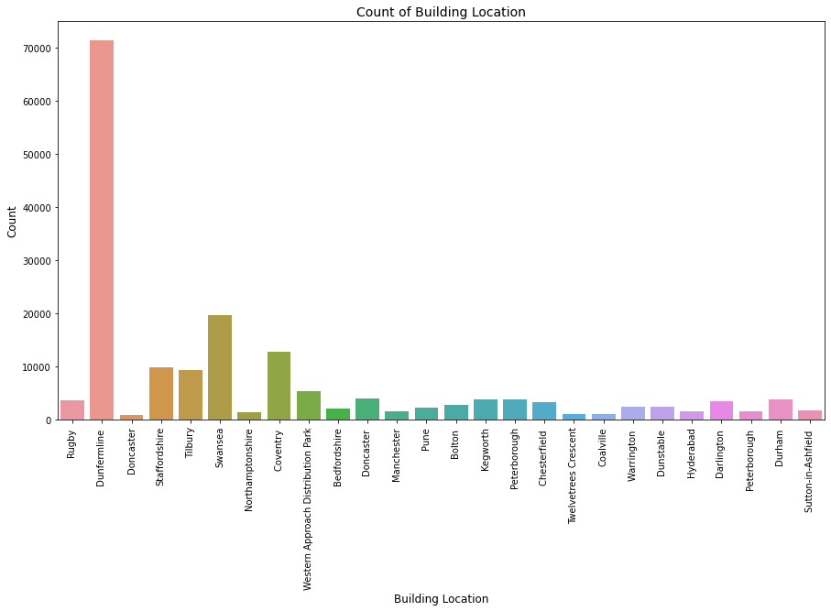
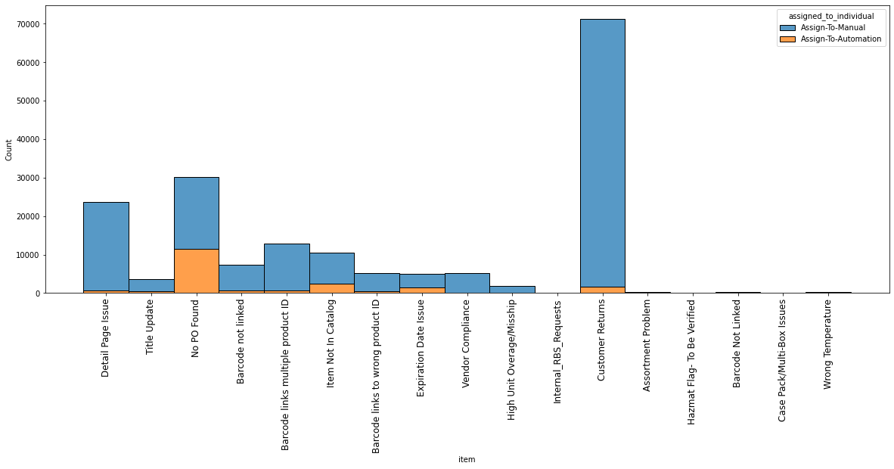
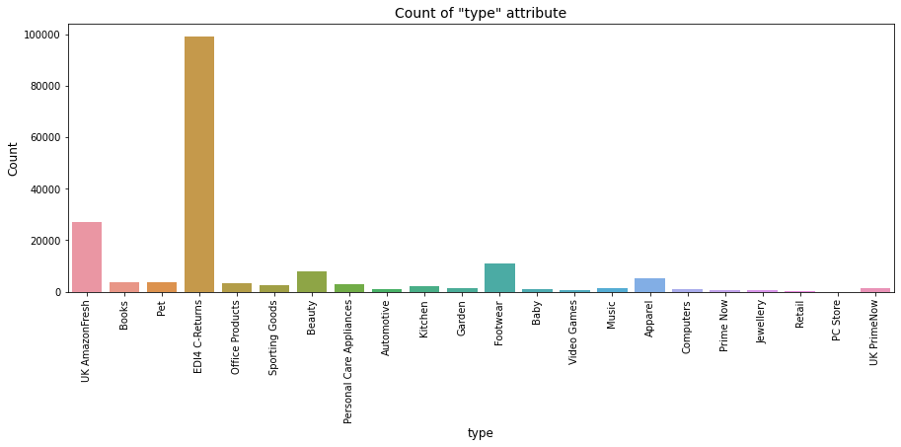
EDA :
Analysis of item with assigned_to_individual

Slide 6
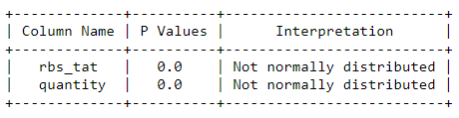
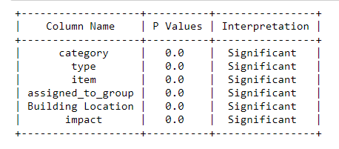
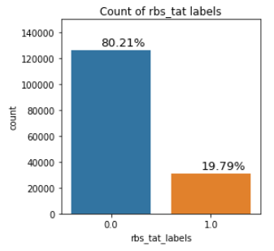

Predictor & Response Variable:
Statistical Tests :
Checking the normality of numerical variables:
Category
Type
Item
Assigned to group
Building Location
Impact
Quantity
Rbs tat (Regression)
Rbs tat labels (Classification)
Spearman
Correlation:
Not correlated.
Chisquare test for checking dependence
of feature & rbs_tat_label :
Kruskal for quantity column and rbs_tat_label:

Slide 7
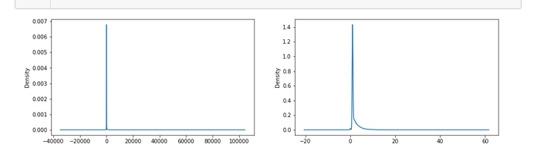
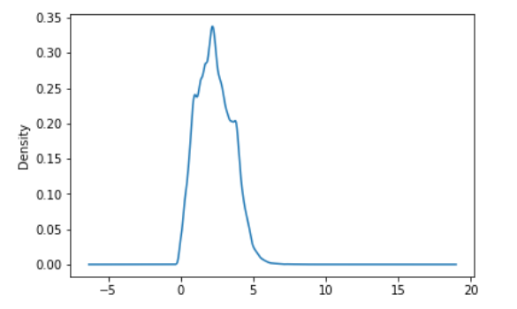
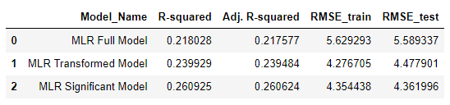
Model Building – Regression:
Base Model OLS:
No autocorrelation, severe multicollinearity, linear relationship between dependant and independent variable, heteroskedasticity present in the data and the residuals are not normally distributed
Overall F-Test & p-value of the Model: Prob (F-statistic): 0.00, i.e. the model is significant.
Transformed Model:
Cube root transformation on Quantity
Square root transformation on Target

Slide 8
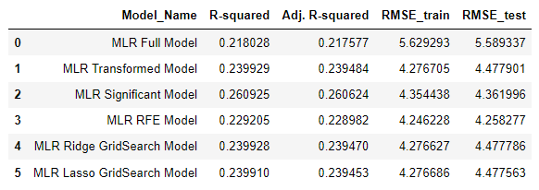
RFE Model:
RFE model was built with Linear Regression as estimator.
35 variables were found to be significant out of 70.
Ridge GridSearch Model:
Ridge model with default parameters were built. (R-sqaure : 0.2399)
GridSearch parameters: alpha = 0.1, random_state = 10, max_iter = 500
Lasso GridSearch Model:
Lasso model with default parameters were built. (R-sqaure : 0.1973)
GridSearch parameters: alpha = 1e-15, random_state = 10, max_iter = 500

Slide 9
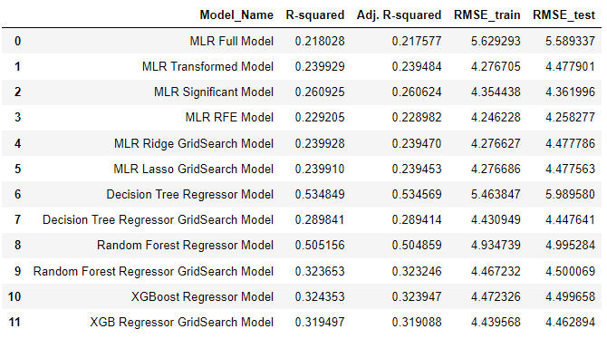
Decision Tree Regressor Model:
GridSearch parameters: criterion = 'mse', max_depth =10, min_samples_leaf = 15, min_samples_split = 7
Random Forest Regressor Model:
GridSearch parameters: n_estimators= 50, criterion = 'mse', max_depth =20, min_samples_leaf = 12, min_samples_split = 25
XGBoost Regressor Model:
A Base XGBoost Regressor is built using parameters: objective ='reg:squarederror',n_estimators = 2000.
GridSearch parameters: objective ='reg:squarederror', n_estimators = 2000, max_depth = 5, gamma =1, alpha = 0.2

Slide 10
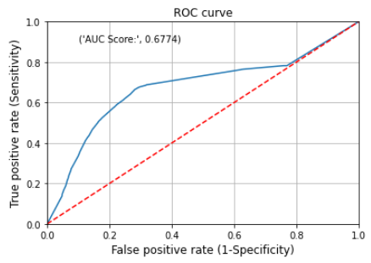
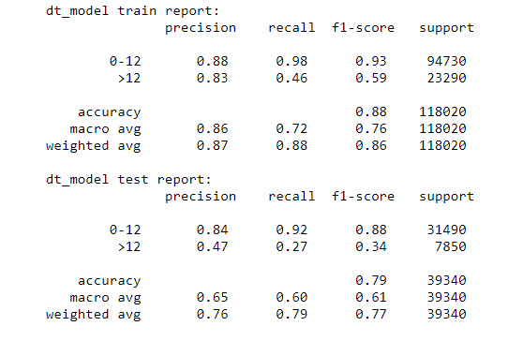
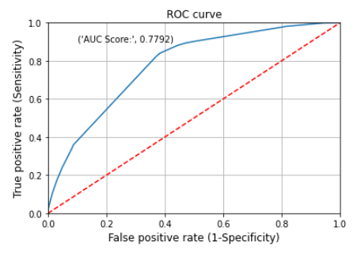
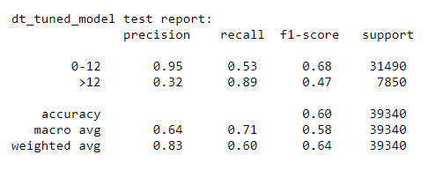
Model Building – Classification :
Decision Tree
Classifier Model:
Decision Tree
Classifier GridSearchCV Model:
criterion = 'entropy' ,
max_depth = 7,
min_samples_split = 20,
min_samples_leaf = 5,
class_weight={‘0-12’: 1, ’>12’: 10}

Slide 11
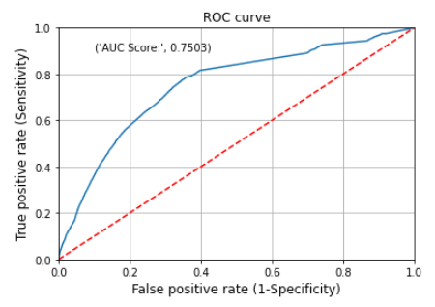
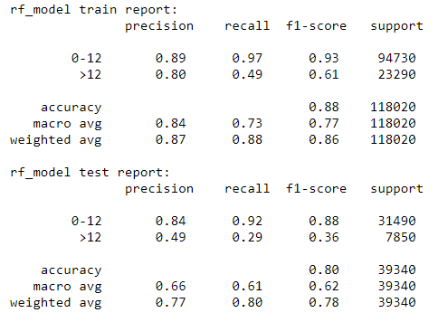
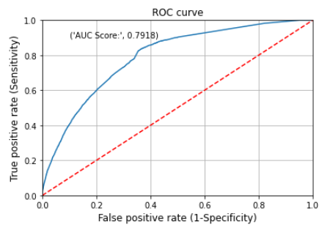
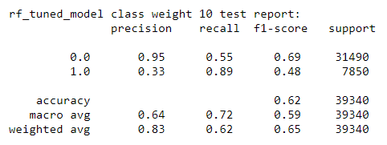

Model Building – Classification :
Random Forest
Classifier Model:
Random Forest
Classifier RandonmizedCV Model:
n_estimators=3500,
class_weight={‘0-12’: 1, ’>12’: 10},
max_depth = 20,
min_samples_split =25 ,
min_samples_leaf = 10,
criterion = 'gini'

Slide 12
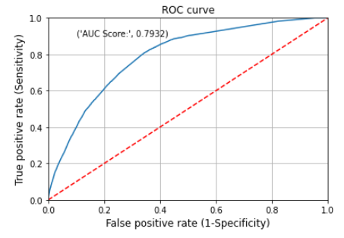
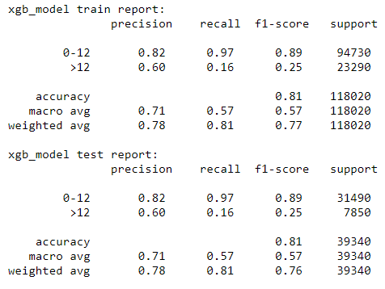
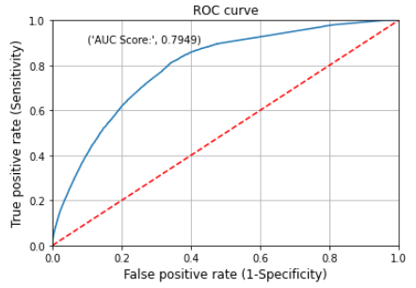
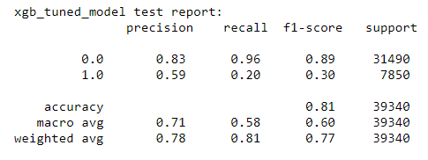
Model Building – Classification :
XGBoost
Classifier Model:
XGBoost
Classifier RandonmizedCV Model:
max_depth =15,
learning_rate = 0.3,
gamma = 2,
n_estimators= 3500,
class_weight={'0-12': 1, '>12': 10}

Slide 13
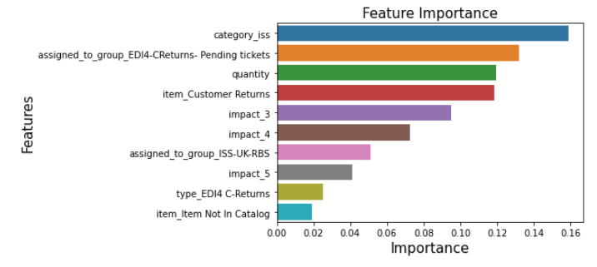
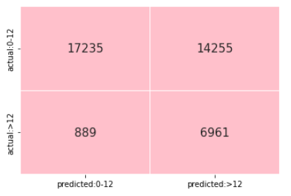
Interpretation :
Classification Models | Recall score - class 1
DT Base Model | 0.27
DT Tuned Model(10) | 0.89
RF Base Model | 0.29
RF Tuned Model (balanced) | 0.83
RF Tuned Model (5) | 0.85
RF Tuned Model (10) | 0.89
Ada Boost Model | 0.20
Gradient Boost Model | 0.19
XGBoost Base Model | 0.16
XGBoost Tuned Model | 0.20
Random Forest Classifier RandomizedCV Model:
If ‘>12’ class gets predicted as ‘0-12’ class it will increase the False Negatives and will fail to prioritize the appropriate tickets which needs more turn-around-time to resolve.
Higher Recall score of ‘>12’ class (class ‘1’ i.e. True Positive) implies a better Model.
TN
FP
FN
TP

Slide 14
Thank You !!!!!

